Slide 1




PROPOSAL FOR RESTURANT WEBSITE
Team Member
Bidhata Dev Thakur
Binaya Pokhrel
Ravi Shankar Sah

Slide 2
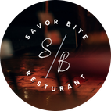
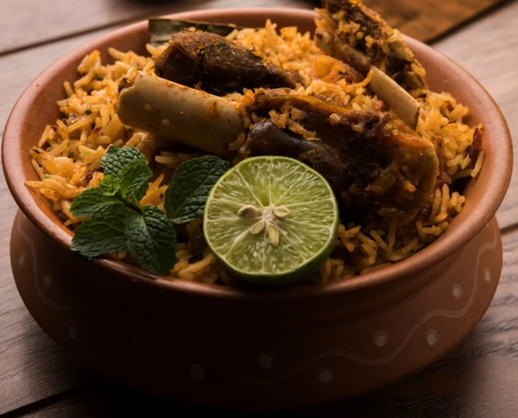
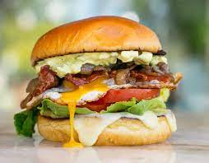
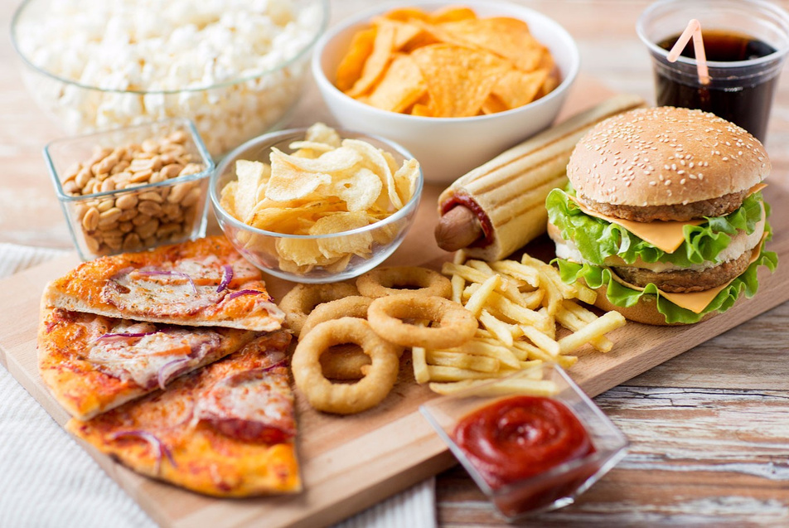

savorbite.com.np
SAVOR
BITE
Experience the new taste of food with SavorBite

Slide 3
INTRODUCTION
Background Study
Savor Bite, the place for amazing food, has a website that makes your dining experience even better. It uses HTML to organize their menu and make it easy to read. With CSS, the website looks pretty and work on phones and computers. It also uses JavaScript to help you find the food you want and even customize your order. Savor Bite’s website isn't just about food; it's about using computer magic to make your dining experience special.

Slide 4
Problem study
ineffectiveness in accessiblity issues in manual order taking procedure
unproper resturant’s digital presence
Objective
to create a HTML program to build a responsive website
to make the menu system more responsive across all platform

Slide 5
Project Feature
Responsiveness
Reliablity
low cost
flexible to user

Slide 6
Feasiblity Analysis
economic Feasiblity - free IDE and open source library
technical feasiblity - laptops/mobile for testing
operational feasiblity - HTML , CSS , JS
System Requirement
hardware - smartphone/laptop with internet connection
software- visual studio , github , browser

Slide 7
EXISTING SYSTEM

Slide 8
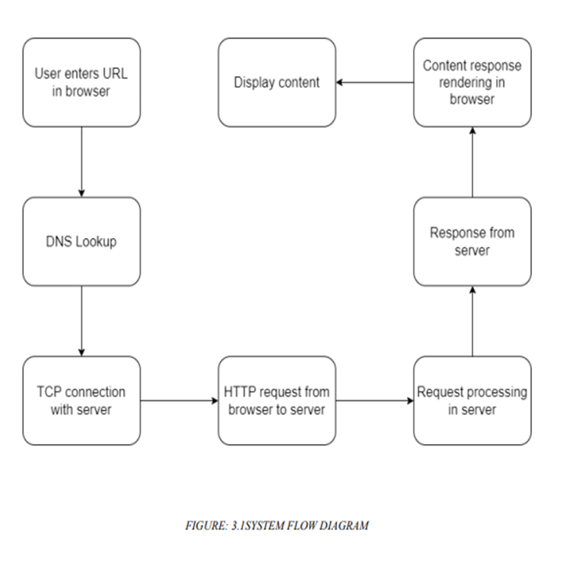
METHODOLOGY
SYSTEM DESIGN
ALGORITM
SYSTEM FLOW DIAGRAM
1.Start
2.Display Welcome Page
3.Scroll Down to View Other Options
4.Select the Option to "Start With"
5.Select the Desired Item
6.Order Now Page Opens
7.Fill in the Order Form
8.Submit the Order Form
9.Display a Confirmation Message
10. Loop back to the Welcome Page (Option to start a new order)
11. End

Slide 9
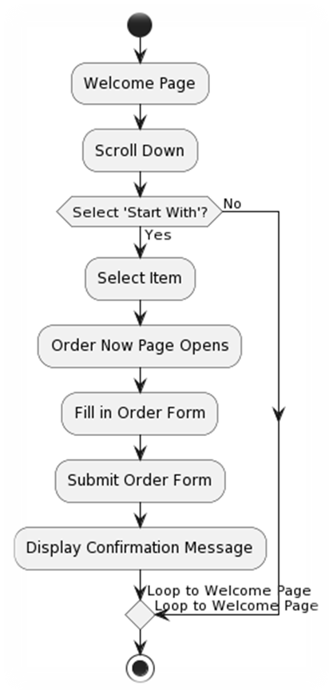
FLOWCHART

Slide 10
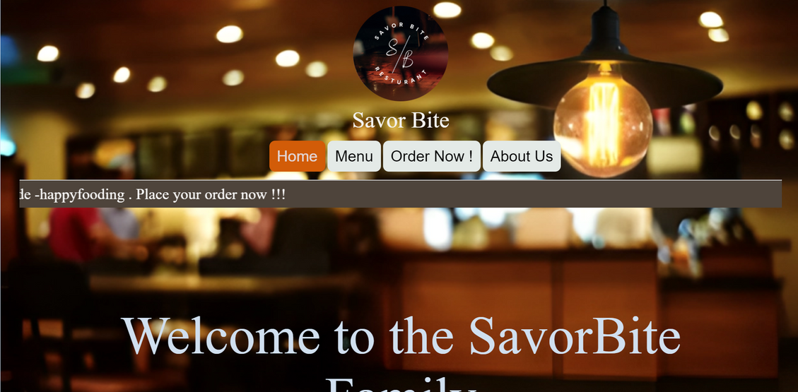
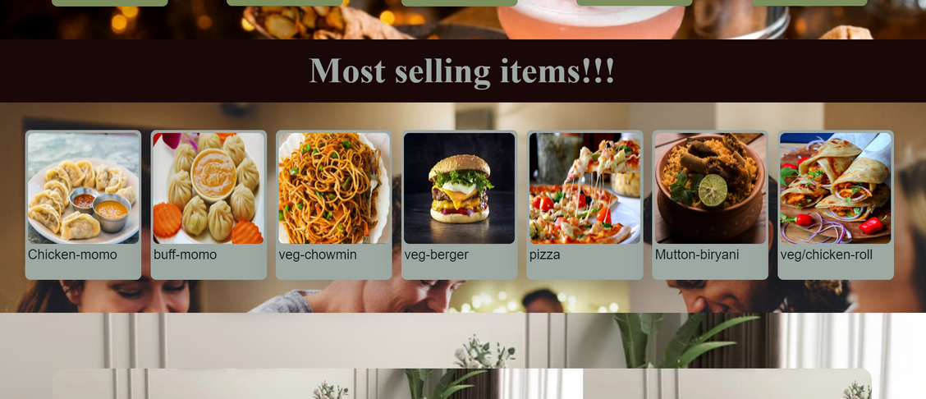
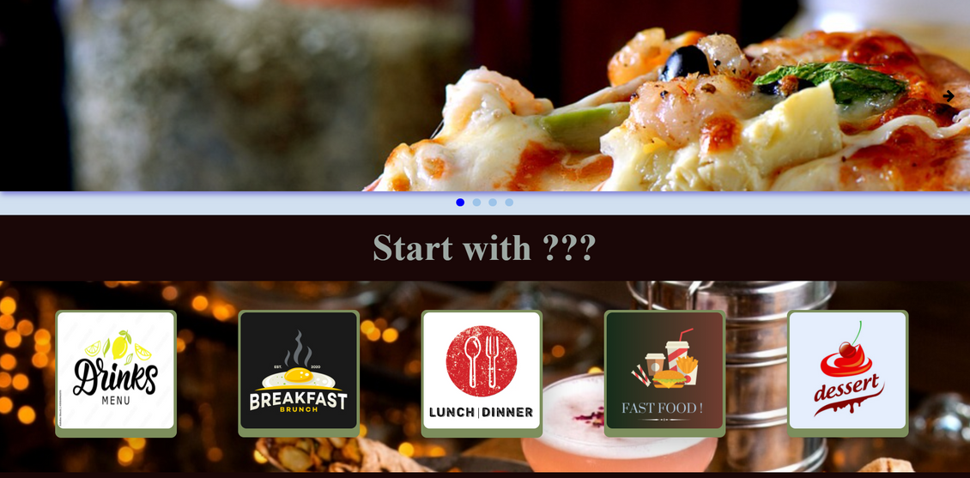
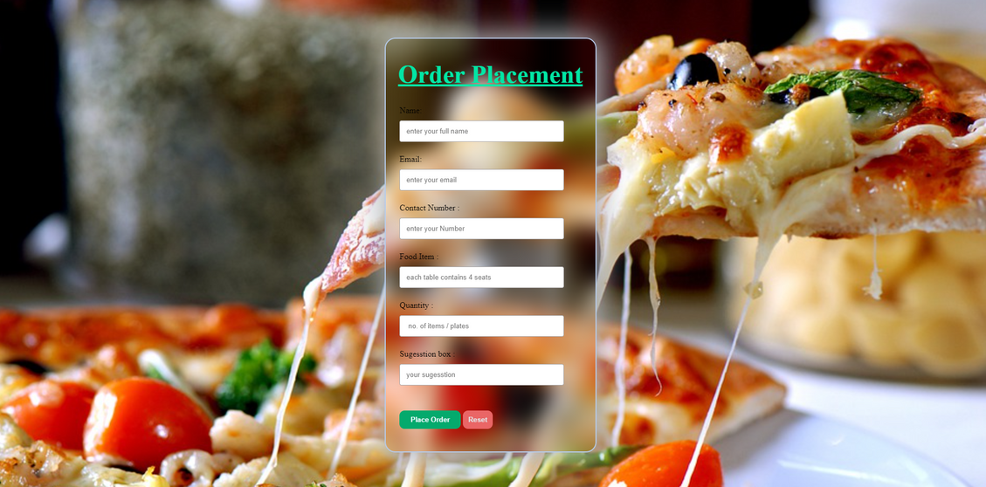
EPILOGUE
Expected Design

Slide 11
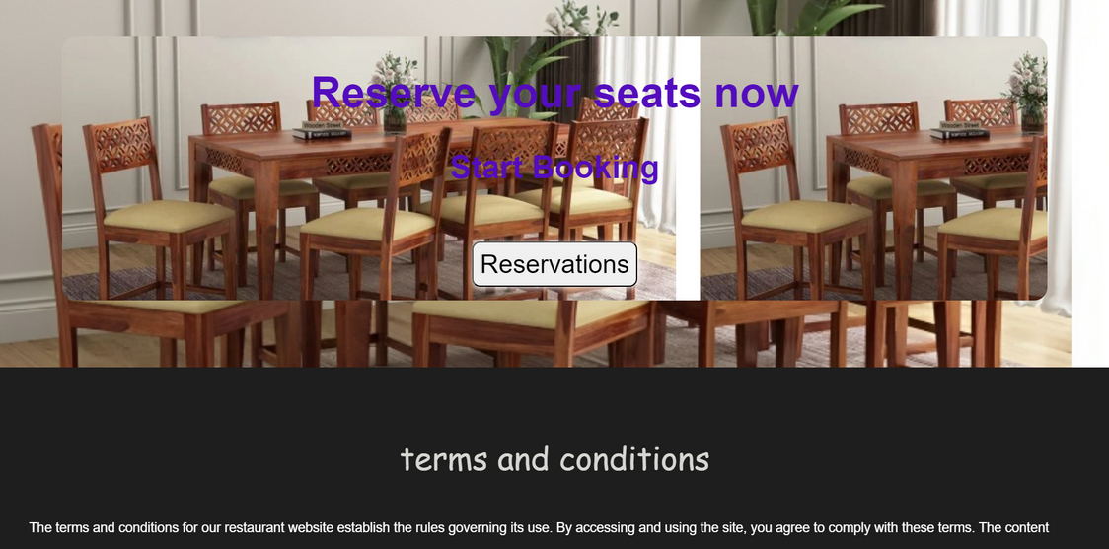
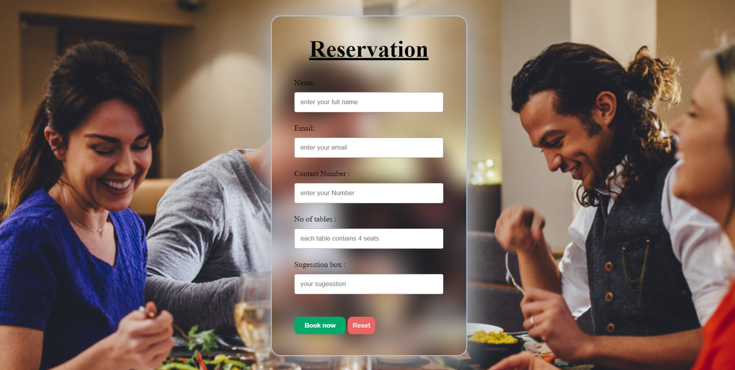
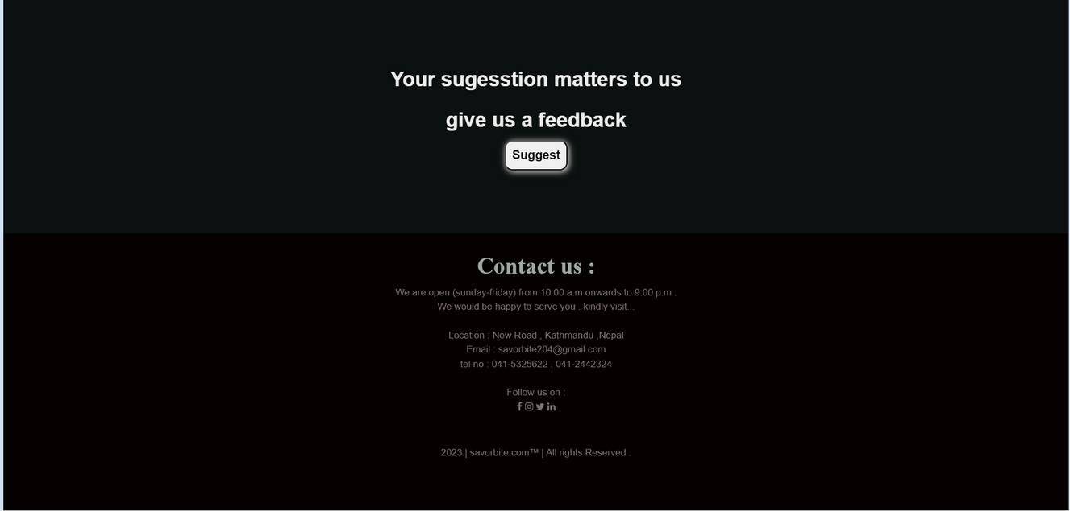

Slide 12
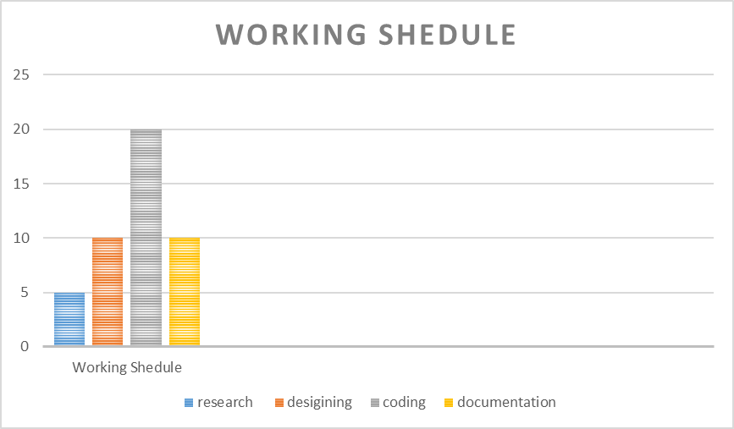
work shedule

Slide 13
LIMITATION
in-effective marketing
security issues

Slide 14
FUTURE WORK
SEO Optimization
User Data Protection
interactive content

